Slide 1


MVSR Engineering College, Hyderabad - 501 510
Department of Computer Science and Engineering
Project Name: Action Detection for Sign Language
Batch No : C3
T. Haritha vani – Roll No 2451-19-733-313
G. Rajitha – Roll No 2451-19-733-316
S. Kamala – Roll No 2451-19-733-318
Under the guidance of
Name: K.V.SRILAKSHMI ASHARANI
Designation-Assistant Prof.,MVSREC

Slide 2
Batch No: C3 Name of the project:Action detection for sign language
Problem Statement: Communication is the process of passing information from one person to another and expressing our thoughts to others. However, there are persons whose speaking or hearing abilities are impaired. Communication presents a significant barrier for persons with such disabilities.
Here, our goal is to create a language via the use of various gestures and signs. Numerous studies have used various SLR techniques, however they wrongly refer to the issue as gesture recognition (GR).Three essential components make up the sign: Hand motions that are manual features; non-manual features include body posture or facial expressions.
Project Scope:Our major aim is to develop sign language recognition using Long short –term memory(LSTM) model to reduce communication barriers. It is based on splitting of continuous signs into sub-units and modeling them with neural networks.
Application Areas:
Education
Health care
Business
Assistive Technology
Challenges:
Sign language is one of the greatest adaptations for persons with speech and hearing impairments. It is also known as a visual language. Generally, it has five basic parameters: hand shape, orientation, movement, location, and components such as mouth shape and eyebrow movements.
In-house Project/ Industry Project : In-house Project
Organization Name : Maturi Venkata Subba Rao Engineering College
Marks:5

Slide 3
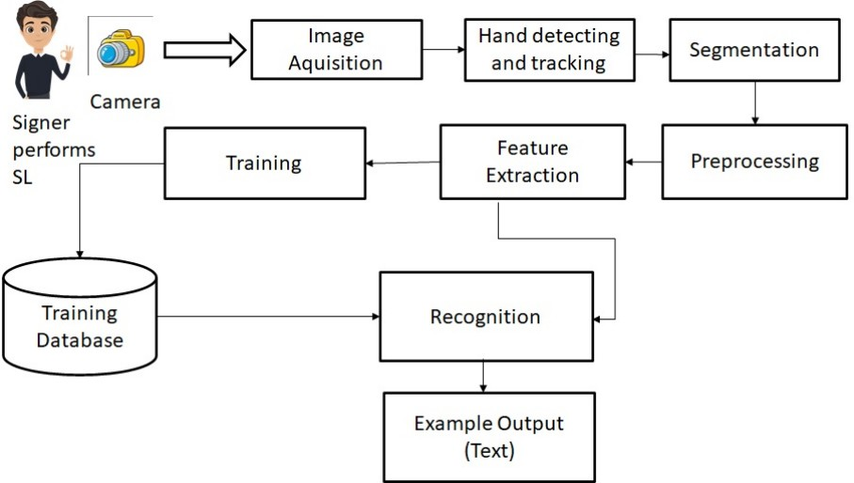
Batch No: C3 Name of the project: Action detection for sign language
Software Requirements :
● Platform - Windows 8 or above
●Technology - Deep Learning
● Operating System - Any OS with clients to access the internet
● Programming Language – Python
Hardware Requirements :
● Processor - Intel i5 or above
● Device -Any device that can access the internet.
● Space on disk - minimum1000MB
● 8GB RAM
● Hard disc 10GB or above
Project Objective:The main objective of this project is to develop sign language recognition using Long short –term memory(LSTM) model to reduce communication barriers. It is based on splitting of continuous signs into sub-units and modeling them with neural networks.The method of separating objects or signs from the context of a captured image is known as segmentation. Context subtracting, skin-color detection, and edge detection are all used in the segmentation process. The motion and location of the hand must be detected and segmented to recognise gestures.Predefined features such as form, contour, geometrical feature, colour feature, histogram, and others are extracted from the pre-processed images and used later for sign classification or recognition. Feature extraction is a step in the dimensionality reduction process that divides and organises a large collection of raw data. Reduced to smaller, easier-to-manage classes as a result, processing would be simpler. The fact that these massive data sets have many variables is the most important feature.
Marks:3

Slide 4
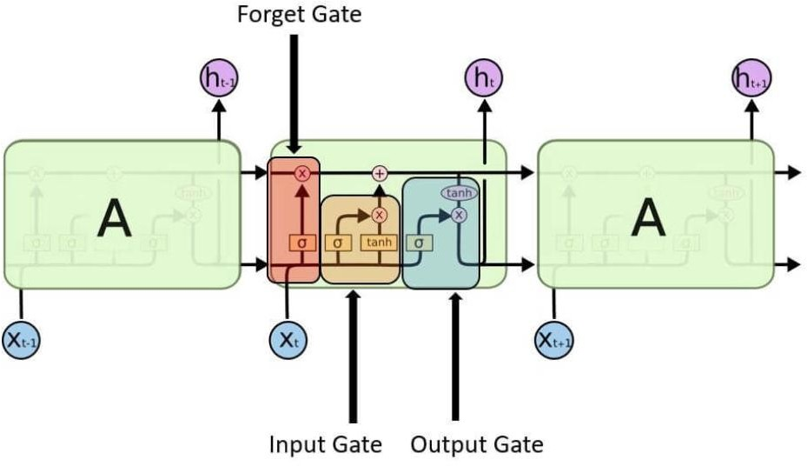
Batch No: C3 Name of the project: Action detection for sign language
Literature Survey: Domain Description
LSTM using RNN
Long Short Term Memory is a kind of recurrent neural network.
In RNN output from the last step is fed as input in the current step.
It is a variety of recurrent neural networks (RNNs) that are capable of learning long-term dependencies, especially in sequence prediction problems.
LSTM has feedback connections, i.e., it is capable of processing the entire sequence of data, apart from single data points such as images.
LSTM (Long Short-Term Memory) is a type of Recurrent Neural Network (RNN) architecture that is designed to overcome the vanishing gradient problem in traditional RNNs.
Traditional RNNs suffer from the vanishing gradient problem, where the gradients used to update the weights in the network become very small as they propagate through many time steps. This can result in the network being unable to learn long-term dependencies.
LSTM networks use a series of memory cells and gates to selectively remember or forget information over time. The three main components of an LSTM cell are the input gate, the forget gate, and the output gate. The input gate controls whether new input is added to the memory cell, the forget gate controls whether information is removed from the memory cell, and the output gate controls what information is output from the memory cell.
Marks:1

Slide 5
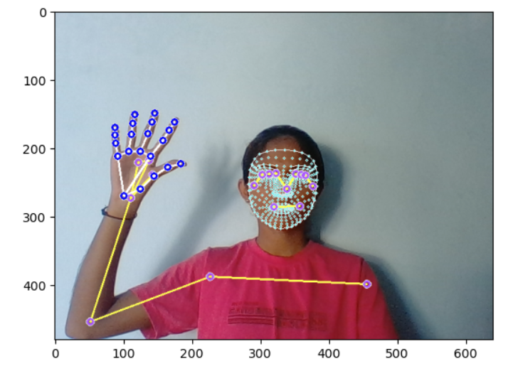
To train our LSTM neural network, first we will be importing the following key dependencies:
Sequential modeling : allows us to build a sequential neural network
LSTM layer : provides temporal component for the Neural Network & allows performing action detection
Dense layer : a normal fully connected layer
TensorBoard : allows to perform logging inside TensorBoard web app for tracing & monitoring model during training

Slide 6

Batch No: C3 Name of the project: Action detection for sign language
Background on Development environment: Specific Software's/API’s to be used
This project is developed using the Python programming language in a Windows 10 environment on a machine with an Intel Core i5 processor running at 2.90GHz.
In this project, the Jupyter notebook Integrated Development Environment (IDE) is used to write the code. Jupyter notebook is a Python programming language integrated
development environment (IDE) created by Fernando Perez and Brian Granger in 2014.
Jupyter Notebook (formerly IPython Notebook) is a web-based interactive computational environment for creating notebooks documents. Jupyter Notebook is built using
several open-source libraries, including IPython, ZeroMQ, Tornado, jQuery, Bootstrap and MathJax. A Jupyter Notebook document is a browser-based REPL containing an
ordered list of input/output cells which can contain code, text, mathematics, plots and rich media. Underneath the interface, a notebook is a JSON document, following a
versioned schema, usually ending with the ".ipynb" extension.
The main parts of the Jupyter Notebooks are: Metadata, Notebook format and list of cells. Metadata is a data Dictionary of definitions to set up and display the notebook.
Notebook Format is a version number of the software. List of cells are different types of Cells for Markdown(display), Code( to execute), and output of the code type cells.
Marks:2

Slide 7
Batch No: C3 Name of the project Action detection for sign language
Dependencies
tensorflow :to develop and train neural networking model
tensorflow-gpu :to leverage dedicated GPU(NVIDIA) for tensorflow
opencv-python :to work with webcams and build our feed
mediapipe :to extract the key-points
sklearn :for train-test split and evaluation metrics
matplotlib :to visualize images better
numpy :to work with array structures
os :to work with file paths
time :to take a sleep between each frame collected
Train_test_split :to create training and testing partitions
To_categorical :to help with labels(convert data into one-hot-encoded format)
Sequential :allows us to build a sequential neural network
LSTM provides temporal component for the Neural network & allows performing action detection
Dense :a normal fully connected layer
TensorBoard allows to perform logging inside TensorBoard web app for tracing & monitoring model during training
Marks:2

Slide 8
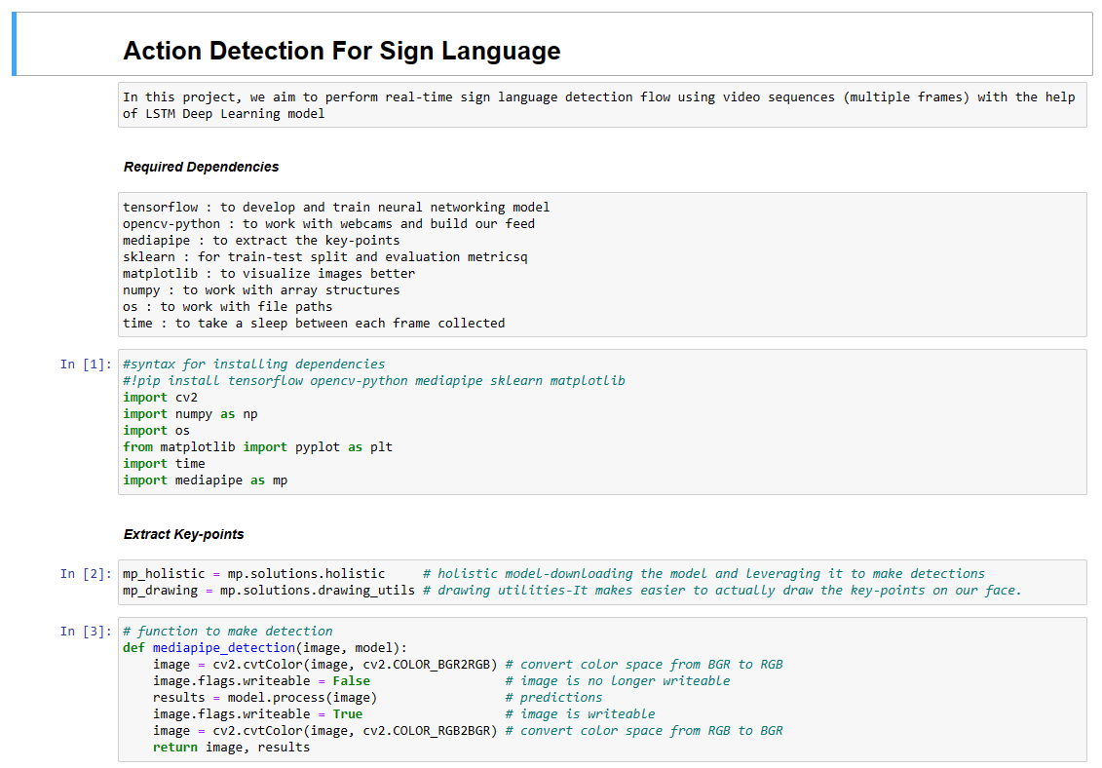
Batch No: C3 Name of the project: Action detection for sign language
Code Implementation

Slide 9
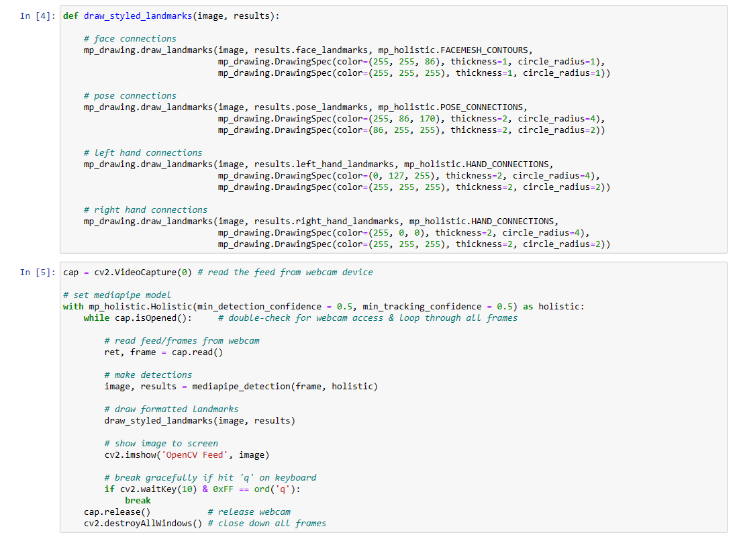
Batch No: C3 Name of the project: Action detection for sign language

Slide 10
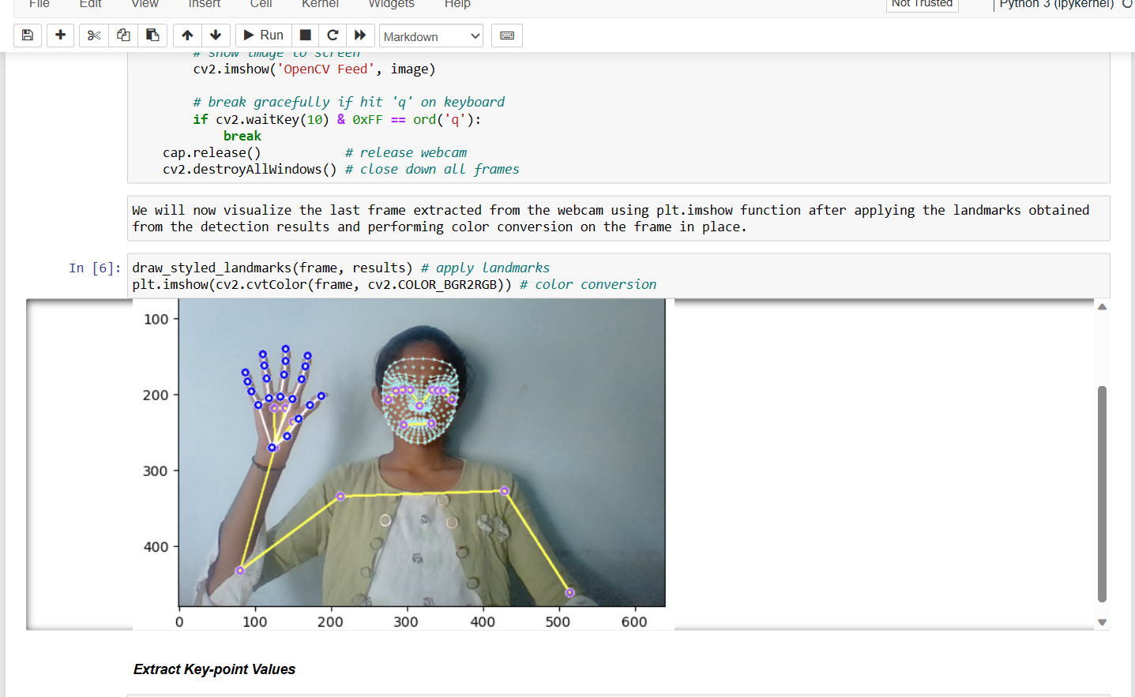
Batch No: C3 Name of the project: Action detection for sign language

Slide 11
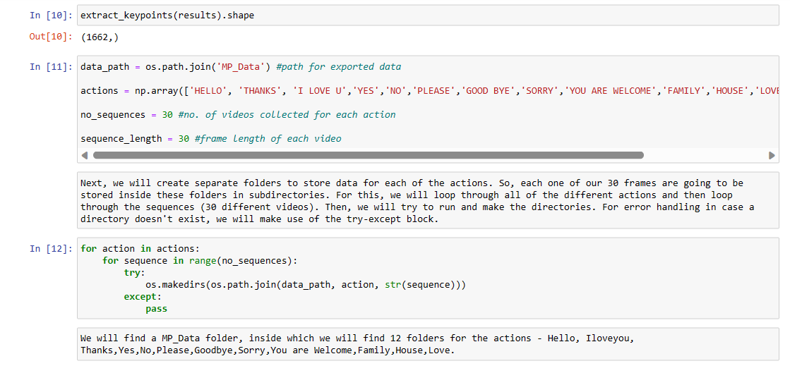
Batch No: C3 Name of the project: Action detection for sign language

Slide 12
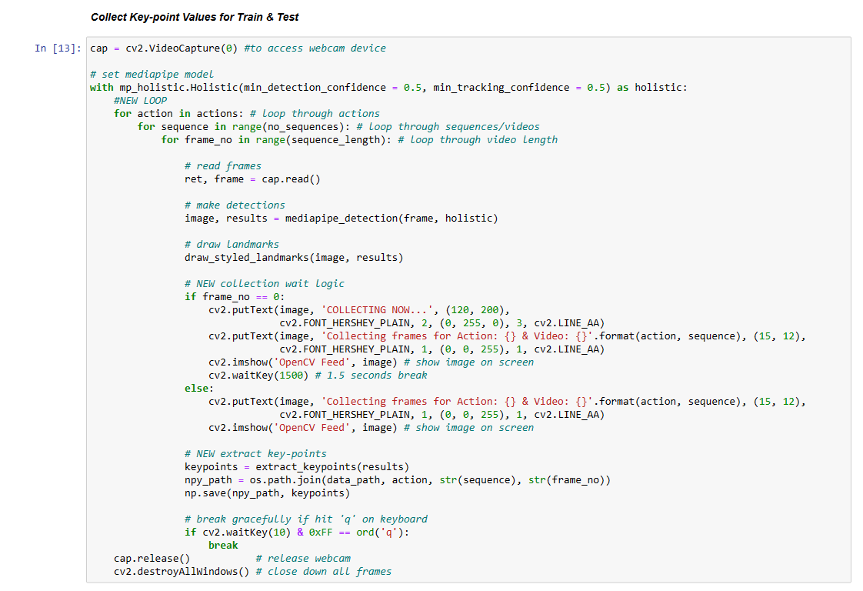
Batch No: C3 Name of the project: Action detection for sign language

Slide 13
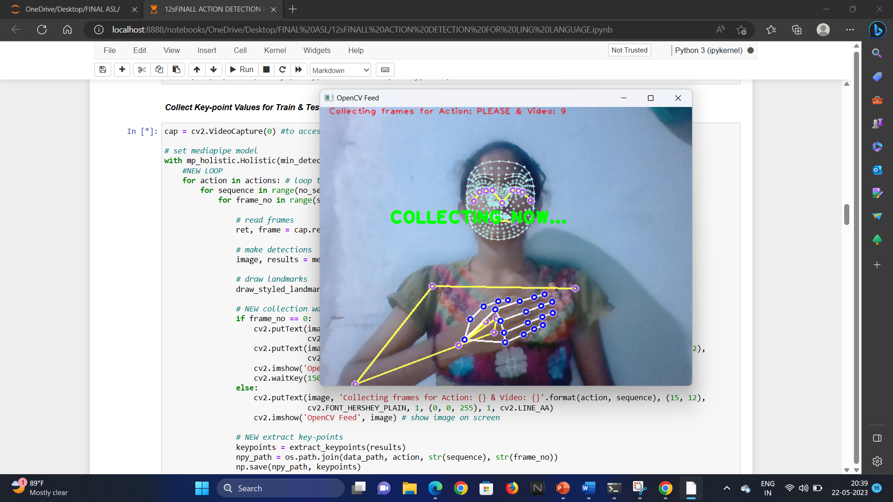
Batch No: C3 Name of the project: Action detection for sign language

Slide 14
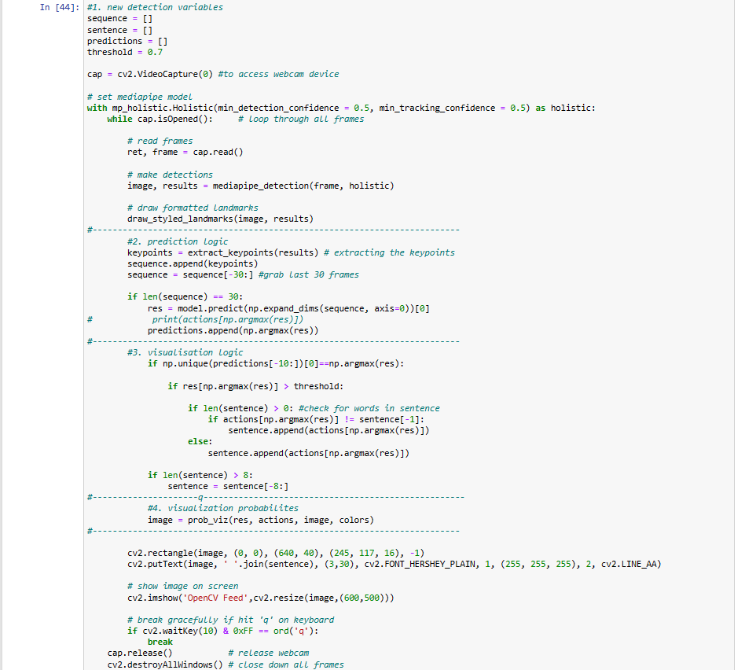
Batch No: C3 Name of the project: Action detection for sign language

Slide 15
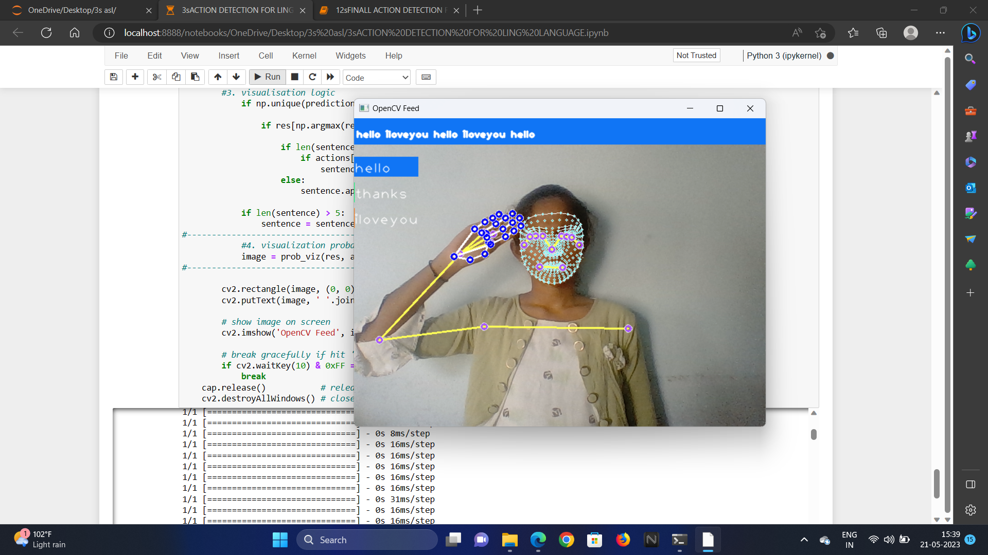
Results
Batch No: C3 Name of the project: Action detection for sign language
Output for 3 gestures

Slide 16
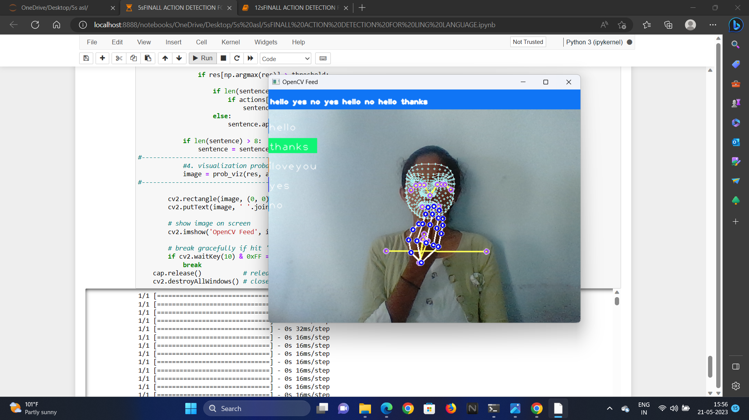
Output for 5 gestures
Batch No: C3 Name of the project: Action detection for sign language

Slide 17
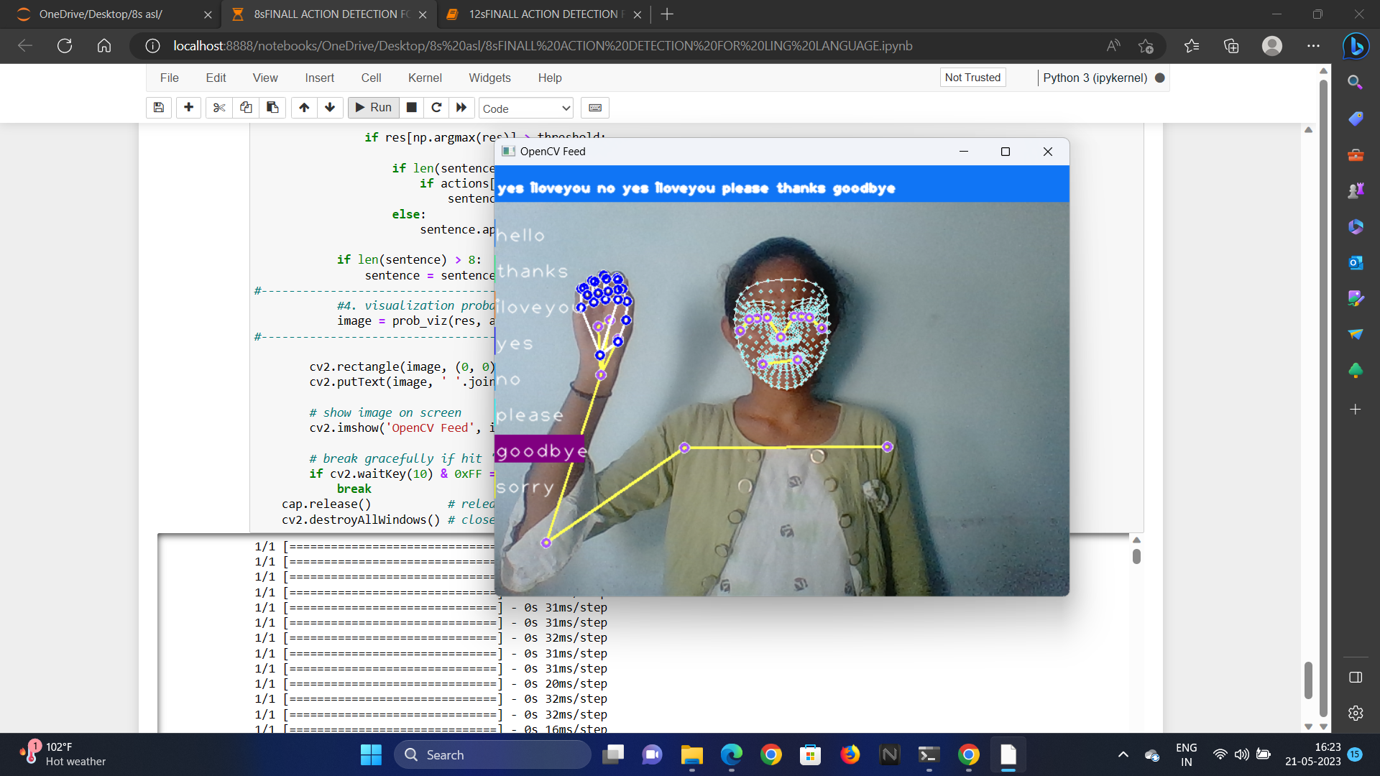
Batch No: C3 Name of the project: Action detection for sign language
Out put for 8 gestures

Slide 18
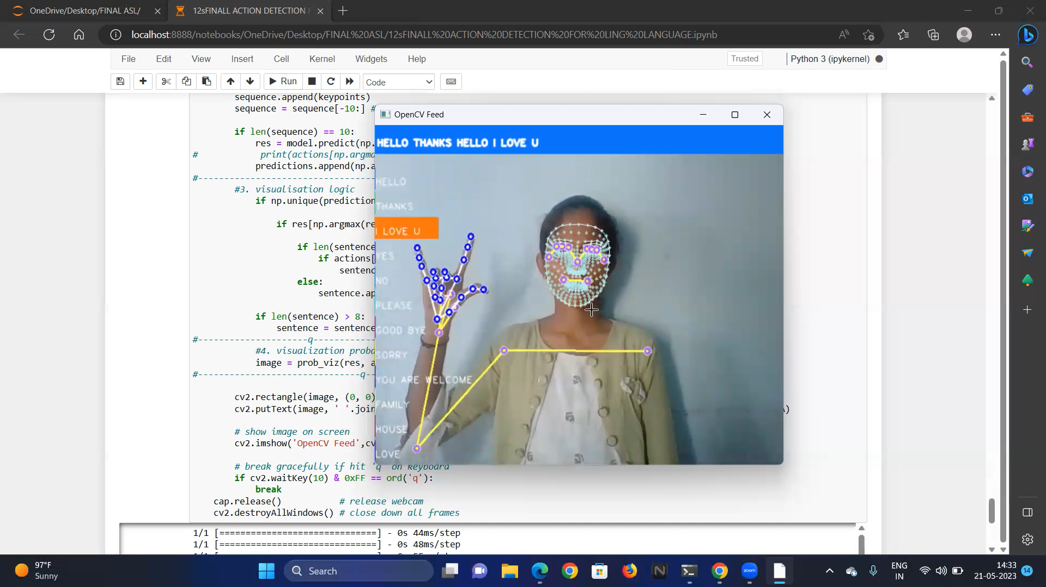
Out put:
Batch No: C3 Name of the project: Action detection for sign language

Slide 19
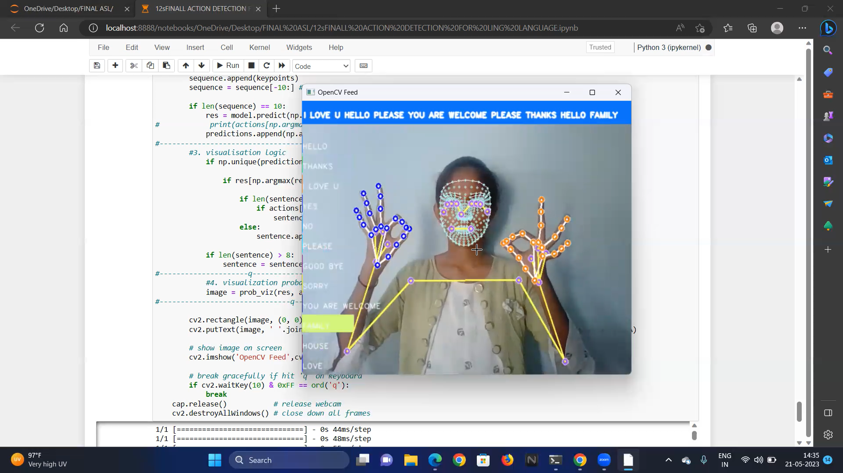
Batch No: C3 Name of the project: Action detection for sign language

Slide 20
Batch No: C3 Name of the project: Action detection for sign language
References
[1]. M. Al-Qurishi, T. Khalid and R. Souissi, "Deep Learning for Sign Language Recognition: Current Techniques Benchmarks and Open
Issues", IEEE Access, vol. 9, pp. 126917-126951, 2021.
[2].M. Jaiswal, V. Sharma, A. Sharma, S. Saini, R. Tomar, “An Efficient Binarized Neural Network for Recognizing Two Hands Indian Sign Language Gestures in Real-time Environment”,2020 https://ieeexplore.ieee.org/abstract/document/9342454
[3].C. J. Sruthi, A. Lijiya, “Signet: A Deep Learning based Indian Sign Language Recognition System”,
[4].https://ieeexplore.ieee.org/abstract/document/8698006
[5].https://ijrpr.com/uploads/V2ISSUE9/IJRPR1329.pdf

Slide 21
Batch No: C3 Name of the project: Action detection for sign language
THANK YOU

